Slide 1
Diagnosis of Breast Cancer from Histopathological Image: ​
An Image Segmentation Approach using Deep Learning​
Supervised By,
Md. Shohel Parvez
Assistant Professor
Dept. of IEM
Presented By,
Emroze Islam
Roll: xxxxxxx
Dept. of IEM

Slide 2
Contents
1. Motivation
2. Introduction
3. Objectives
4. Methodology
5. Analysis
6. Outcomes
7. Novelty
References

Slide 3
1 Motivation
In Bangladesh,
The breast cancer rate is about 22.5 per 100000 females. The rate is 19.3 per 100000 females aged between 15 to 44 years old (Begum et al., 2019).
6783 patients out of 13028 didn't survive in 2020 (Sung et al., 2021).

Slide 4
2 Introduction
Early diagnosis and treatment is crucial for the survival of patients
Manually analyzing breast cancer H&E images taken by a microscope is a tiresome job and prone to human error.
Deep learning based segmentation method can be used to make this process simpler and accurate

Slide 5
3 Objectives
To collect, analyze and preprocess histopathological data(Image).
To develop multiple segmentation models using deep learning for localizing nuclei in given breast histopathological images.
To evaluate the performance of each model.
To compare all these models with each other.

Slide 6
4 Methodology
Step 1
Step 2
Step 3
Step 4
Step 5
Step 6
Data
Collection
Data Preproces-sing
Defining multiple
deep
learning models for segmentation.
Model Training
Evaluation and Retraining
Performance Comparison and Prediction

Slide 7
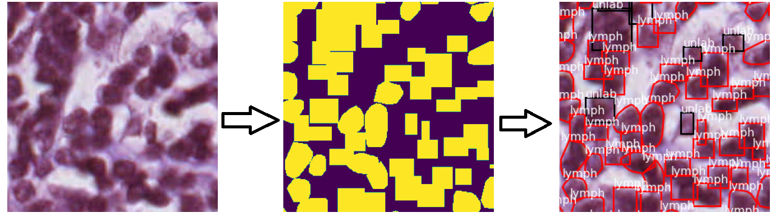
5 Analysis
The NuCLS dataset has 1744 images in .png format (Amgad et al., 2021).
There are 59,485 nuclei and each pixel represents 0.2 micron.
Each pixel represents 0.2 micron.
All images were center cropped at 256*256 resolution.
Sample image, corresponding mask and visualization

Slide 8
5 Analysis (Cont.)
Models Description
Special type of convolutional neural network called “UNet” was used(Ronneberger et al., 2015).
UNet doesn’t have any dense layer.
3 different UNet backbones were used for 3models. They are
Inception-V3
ResNet-34
EfficientNet B2
All the backbones were initialized with ImageNet weights for transfer learning.

Slide 9
5 Analysis (Cont.)
Hyper-parameters | Value
Optimizer | Adam
Learning Rate | 0.00005
Loss Function | Focal Jaccard Loss
Batch Size | 8
Steps per epoch for training | 196
Steps per epoch for Validation | 21
Epoch | 80
Activation Function | Softmax and ReLU

Slide 10
5 Analysis (Cont.) Performance of models
UNet Backbone |  | IOU Score | Focal Jaccard Loss | F-Score
Inception V3 | Training | 0.8494 | 0.1743 | 0.9178
 | Validation | 0.7020 | 0.3767 | 0.8220
EfficientNet B2 | Training | 0.8317 | 0.1950 | 0.9072
 | Validation | 0.7060 | 0.3684 | 0.8253
ResNet-34 | Training | 0.8539 | 0.1694 | 0.9205
 | Validation | 0.7019 | 0.3798 | 0.8223

Slide 11
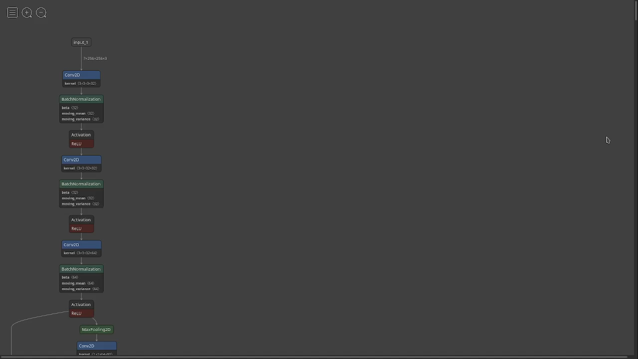
Analysis(Cont.) [Model Visualization]
UNet with Inception-V3 backbone visualization

Slide 12
UNet (Inception-V3 Backbone)Summary
Analysis(Cont.) [Model Description]

Slide 13
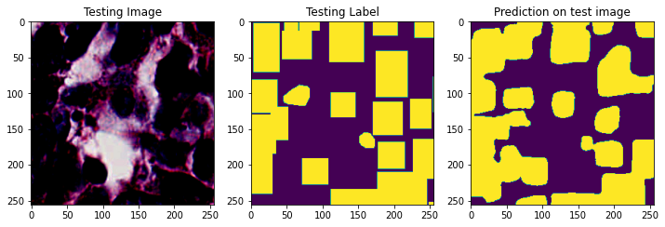
6 Outcomes
The final outcome is 3 trained Deep Neural Networks. When a histopathological image is given, each of them can predict the location of nuclei.
Mask prediction when using Inception-V3 as backbone

Slide 14
7 Novelty
The dataset was published in 2021 and we have trained UNet based CNNs on this dataset. No work was found that have used UNet with this dataset for segmentation purpose.

Slide 15
References
Begum, S.A., Mahmud, T., Rahman, T., Zannat, J., Khatun, F., Nahar, K., Towhida, M., Joarder, M., Harun, A., Sharmin, F., 2019. Knowledge, Attitude and Practice of Bangladeshi Women towards Breast Cancer: A Cross Sectional Study. Mymensingh Med J 28, 96–104.
Sung, H., Ferlay, J., Siegel, R.L., Laversanne, M., Soerjomataram, I., Jemal, A., Bray, F., 2021. Global Cancer Statistics 2020: GLOBOCAN Estimates of Incidence and Mortality Worldwide for 36 Cancers in 185 Countries. CA: A Cancer Journal for Clinicians 71, 209–249.
Amgad, M., Atteya, L.A., Hussein, H., Mohammed, K.H., Hafiz, E., Elsebaie, Maha A T, Alhusseiny, A.M., AlMoslemany, M.A., Elmatboly, A.M., Pappalardo, P.A., Sakr, R.A., Mobadersany, P., Rachid, A., Saad, A.M., Alkashash, A.M., Ruhban, I.A., Alrefai, A., Elgazar, N.M., Abdulkarim, A., Farag, A.-A., Etman, A., Elsaeed, A.G., Alagha, Y., Amer, Y.A., Raslan, A.M., Nadim, M.K., Elsebaie, Mai A T, Ayad, A., Hanna, L.E., Gadallah, A.M., Elkady, M., Drumheller, B., Jaye, D., Manthey, D., Gutman, D.A., Elfandy, H., Cooper, L.A.D., 2021. NuCLS: A scalable crowdsourcing, deep learning approach and dataset for nucleus classification, localization and segmentation. CoRR abs/2102.09099.
Ronneberger, O., Fischer, P., Brox, T., 2015. U-net: Convolutional networks for biomedical image segmentation, in: International Conference on Medical Image Computing and Computer-Assisted Intervention. pp. 234–241.

Slide 16
Thank You All

Slide 17
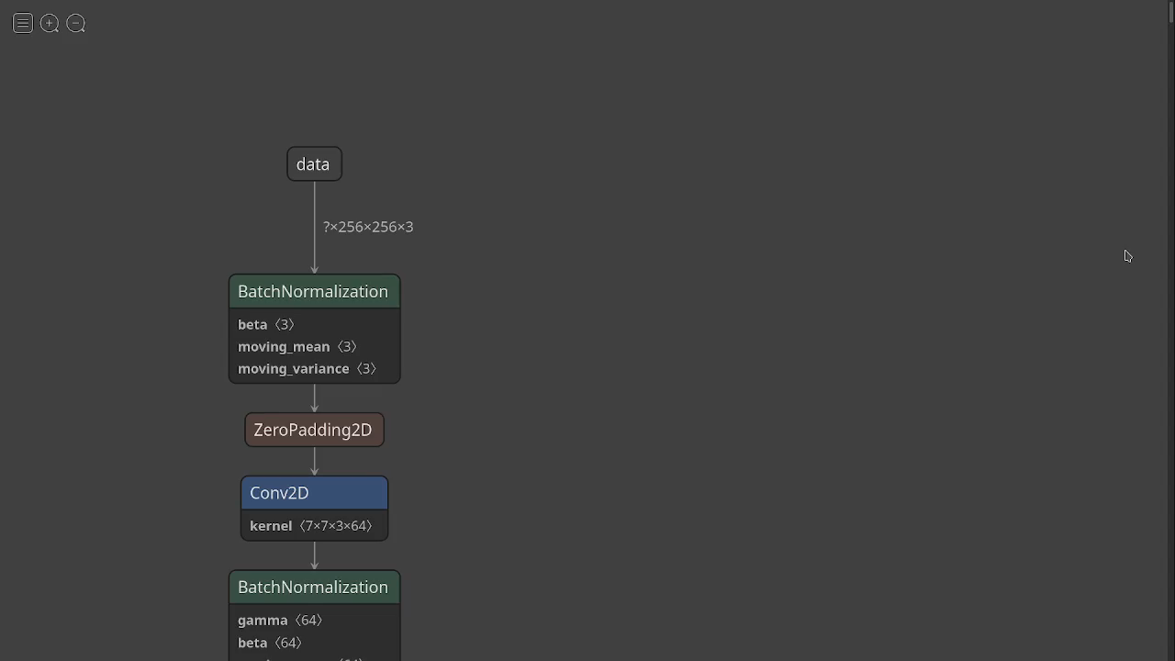
Unet with ResNet-34 Visualization

Slide 18
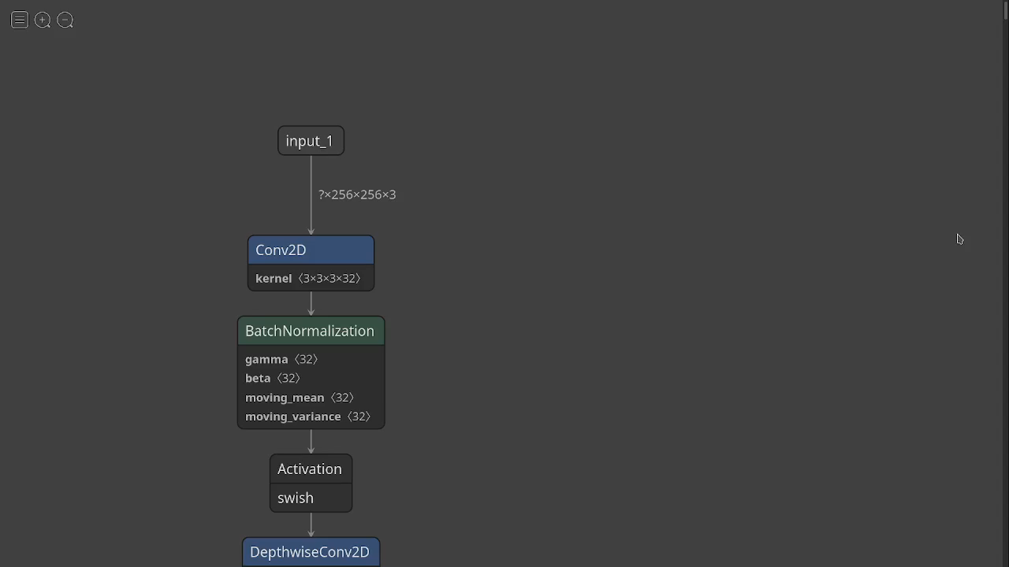
Unet with EfficientNet B2 Visualization

Slide 19
UNet (ResNet-34 Backbone) Summary

Slide 20
UNet(EfficientNet B2) Summary

